Slide 1
INTEL Unnati Industrial Training - 2025
Title: ComicCrafter AI
Team no: 5
Sri Sairam College of Engineering, Bangalore
Team members :
Kanam Khushi Kumari
Pooja Basavaraj Nilugal

Slide 2
Problem Statement:
ComicCrafter AI is a generative AI based comic generator running locally on edge devices that generates a comic style story based on the input prompts given by the user.

Slide 3
Project Overview:
Uses AI for storytelling and illustration.
Generates 4-panel comic strips.
Blends text generation (Mistral-7B/GPT-2) and image generation (Stable Diffusion).
Features a vintage 1940s cartoon aesthetic.
Provides an intuitive web interface using Gradio.

Slide 4
Key Features:
AI-powered storytelling.
Panel segmentation for structured comics.
Vintage cartoon-style illustrations.
Automated comic layout.
Interactive Gradio-based UI.

Slide 5
Technical Highlights:
Text Generation:
Uses Mistral-7B (or GPT-2 fallback).
4-bit quantization for efficient GPU usage.
Image Generation:
Stable Diffusion for high-quality illustrations.
FP16 precision for faster processing.
User Interface:
Gradio-based web app.
Custom CSS styling for modern look.

Slide 6
Story & Illustration Process
User inputs a story idea.
AI generates a short narrative (~300 tokens).
Story is split into 4 segments.
Each segment is illustrated using AI-generated images.
Final comic strip is assembled with structured panels.

Slide 7
Conclusion & Deployment
ComicCrafter AI automates storytelling and illustration.
Generates visually appealing comics with minimal user effort.
Deployed via Gradio for easy web access.
Future improvements: More art styles, enhanced text coherence, multilingual support.

Slide 8
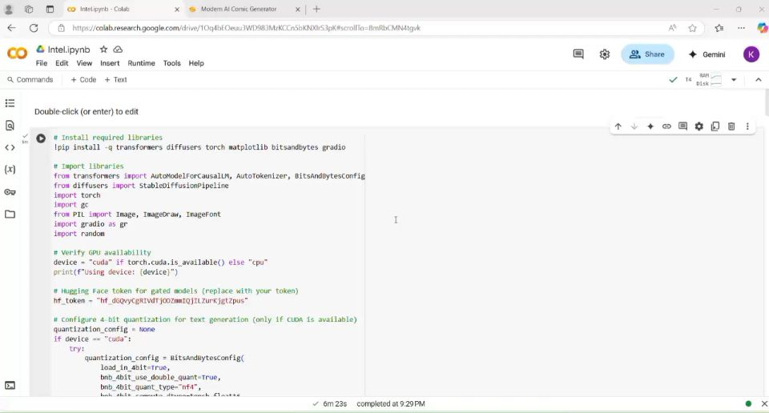
Video Demo:

